Slide 1

Network Security on Cloud
Amit Kumar Jaiswal
PhD student Researcher. Lecturer-researcher , 2 course Group A01-305b
Department of Intelligent Information Systems and Technologies

Slide 2
Adopting cloud-based infrastructure necessitates the use of cloud network security to safeguard your data and applications. So, what exactly is cloud network security? Why is cloud network security necessary, and how does it differ from traditional network security?
Continue reading to find all the answers and best practices for securing your cloud networks. Learn more about Google Cloud's native network security features and how they may help you safeguard your data, services, and infrastructure.

Slide 3
What is cloud network security?
Cloud network security, like cloud security, relates to the technology, rules, controls, and procedures used to safeguard data, but it is specifically concerned with securing cloud networks from unauthorized access, modification, abuse, or disclosure.
Cloud network security is one of the core levels of cloud security, allowing businesses to implement security monitoring, threat prevention, and network security policies to assist manage the risks associated with the dissolving network perimeter.

Slide 4
Why is cloud network security important?
When you use the cloud, you are pushing outside the traditional on-premises border. Whether you’ve moved completely to the cloud, or are using a hybrid-cloud approach, trust in your cloud service provider and trust in your own systems are incredibly important concerns.
When you extend your existing network to cloud environments, it has many security implications. Historically, any on-prem approach involved a distinct perimeter between the internet and your organization’s internal network and a variety of multi-layered defenses like physical firewalls, routers, intrusion detection, and more. But as more workloads and users move beyond your on-prem perimeter, it becomes harder to detect and respond to intrusions using previous perimeter protections to create a secure network.
To stay up with the speed of current IT systems, enterprises want a simpler solution to deploy, manage, and expand network security that is incorporated directly into the cloud. Cloud network security allows you to reduce risk, satisfy regulatory needs, and operate in a secure and efficient manner.

Slide 5
Cloud network security benefits
Improved security visibility
Policy-based security
Advanced threat prevention
Automated monitoring and configuration
Encryption by default
Centralized, consistent security

Slide 6
Improved security visibility
Cloud-based network security allows for centralized security monitoring and control, generally via a single pane of glass. Solutions may also be integrated with current on-premises solutions to assist simplify security in cloud settings.

Slide 7
Policy-based security
Enforcing security and organizational rules may be tough, especially when you have to create, deploy, and enforce them across many cloud and hybrid environments. Cloud network security makes it easy to administer and change specific policies.

Slide 8
Advanced threat prevention
Cloud service providers invest in cutting-edge technology, highly qualified personnel, and strategic alliances with seasoned leaders to deliver real-time detection and powerful protection of intrusions, DDoS assaults, and other web-based threats.

Slide 9
Automated monitoring and configuration
Highly scalable networks require security solutions and practices that can expand alongside them without overwhelming security staff. Cloud network security solutions may automate configuration and management, reducing mistakes and allowing for better traffic control.

Slide 10
Encryption by default
Encryption cannot prevent breaches or security events, but it can mitigate the harm if one occurs. Most cloud providers provide encryption services to safeguard data at rest and in transit, therefore reducing the possible attack surface and preventing unauthorized access if data is intercepted.

Slide 11
Centralized, consistent security
Cloud network security helps to centralize protection by providing built-in security features and tools that allow you to monitor your network activity for possible threats and performance, as well as manage identity and access from one location.

Slide 12
Cloud network security challenges
Network and cloud security may be problematic for many of the same reasons why cloud computing is so effective in accelerating digital transformation.
Cloud infrastructure can be scaled up or down automatically, reducing the strain on development and security teams. Containers, serverless computing, and autoscaling technologies ensure that cloud infrastructures are rarely static and continually adapt to changing demands. This is made much more difficult by the growing popularity of hybrid systems, which combine on-premises and cloud networks.
It makes determining overall network security challenging, as well as tracking down hostile actors as they travel across networks, especially if security teams must switch between several platforms and security tools.
Furthermore, network security in cloud computing is a shared duty between the user and the cloud provider. Shared responsibility models differ depending on the source. As the network owner, you are frequently in charge of safeguarding your cloud assets, which include network controls, identity and access management, data, and apps. It is critical that these operations are properly defined, since any misunderstanding might result in significant gaps in coverage.

Slide 13
Cloud network security best practices
Deploy zero-trust networks
Secure internet-facing services
Secure connections between all of your environments
Micro-segment access
Understand your shared responsibilities

Slide 14
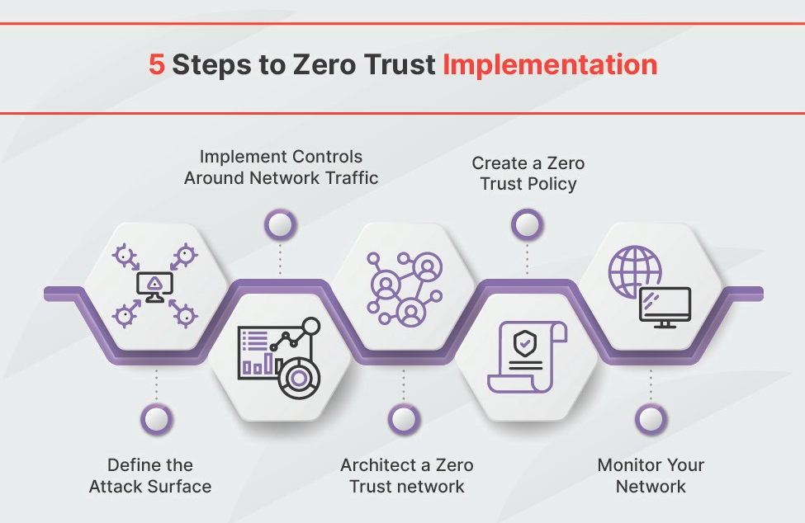
Deploy zero-trust networks
The zero-trust security concept states that no one or nothing is trusted by default, whether they are within or outside of your network. Zero trust allows you to delegate access control from the network perimeter to specified users and devices.

Slide 15
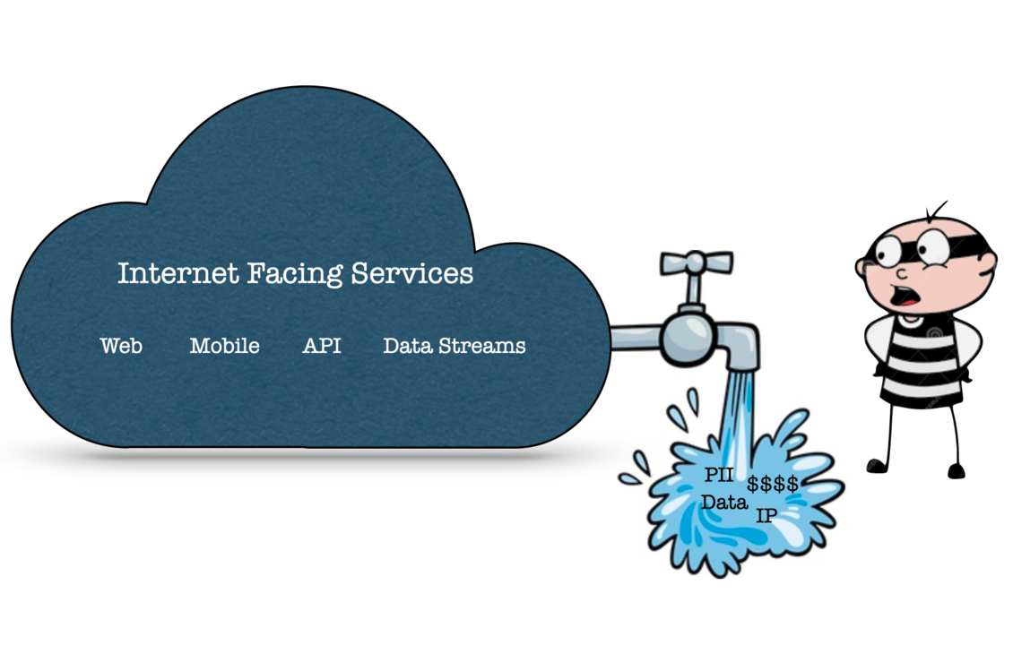
Secure internet-facing services
In general, it is recommended to block internet access to your cloud resources unless absolutely essential. However, if you can't prevent it, network-level security in the cloud can help limit access. This covers edge network security with DDoS protection, web application firewall (WAF) policy enforcement, identity-aware control access, and intelligent threat identification via real-time monitoring, logging, and alerting.

Slide 16
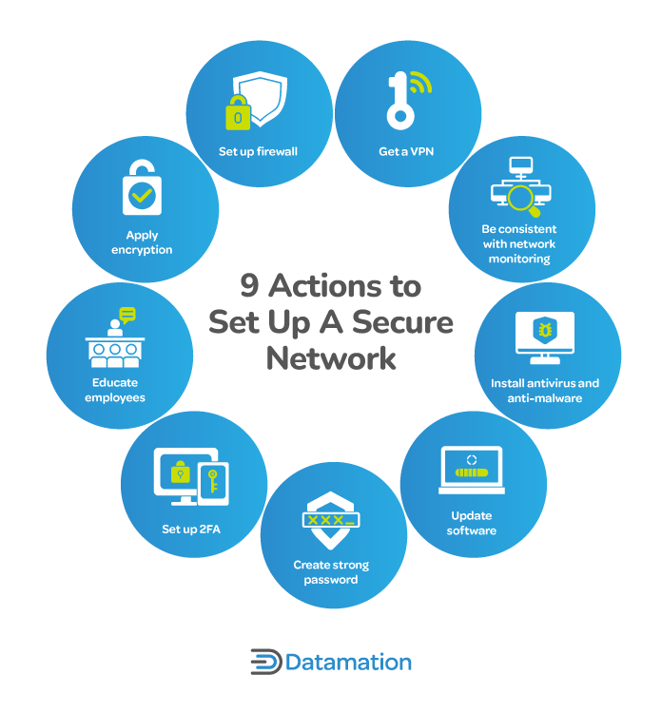
Secure connections between all of your environments
Your workloads may be hosted on-premises, in the cloud, or in several cloud environments. That is why it is vital to protect connections to your environments in order to make deployments as private as possible and decrease vulnerability to attacks. You may avoid disrupting key operations by providing private access options that allow cloud-based or on-premises clients to interact and consume compatible APIs and services without requiring an external IP address.

Slide 17
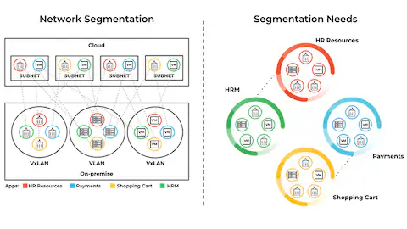
Micro-segment access
Even within your network, it is critical to control and monitor communication between applications and services. If an attacker infiltrates your network, micro-segmentation can assist restrict lateral movement by implementing fine-grained security policies that govern traffic accurately. You may also utilize micro-segmentation strategies to separate essential systems and improve regulatory compliance.

Slide 18
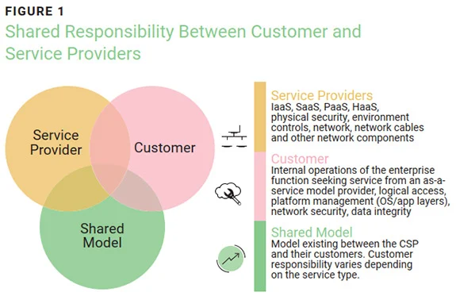
Understand your shared responsibilities
To establish robust network security in cloud computing, it is critical to identify your weaknesses. Understanding your duties and the controls incorporated in your cloud provider's services is crucial. For example, you may search for a cloud provider that follows a shared fate model, in which providers provide more thorough information, resources, and tools to assist customers in better navigating risk management and security.

Slide 19
Conclusion
Cloud network security is an important feature of contemporary corporate infrastructure, especially as firms rely more on cloud services for data storage and processing. The dynamic nature of cloud systems creates new problems and hazards, needing strong security measures to safeguard sensitive data from unauthorized access and cyber attacks. Effective cloud network security requires a complex approach that incorporates identity and access management (IAM), data encryption, firewalls, and intrusion prevention systems. These technologies collaborate to establish a secure environment by limiting who may access data, ensuring that data is unreadable during transmission and storage, monitoring network traffic for suspicious activities, and responding to possible threats in real time. The shared responsibility model further complicates security measures, as both the cloud service provider and the organization must collaborate to safeguard data effectively.

Slide 20
References
4. Сетевая безопасность / Network Security
Chris Dotson. Practical Cloud Security. A Guide for Secure Design and Deployment. // 2024. pp. 230

